Slide 1

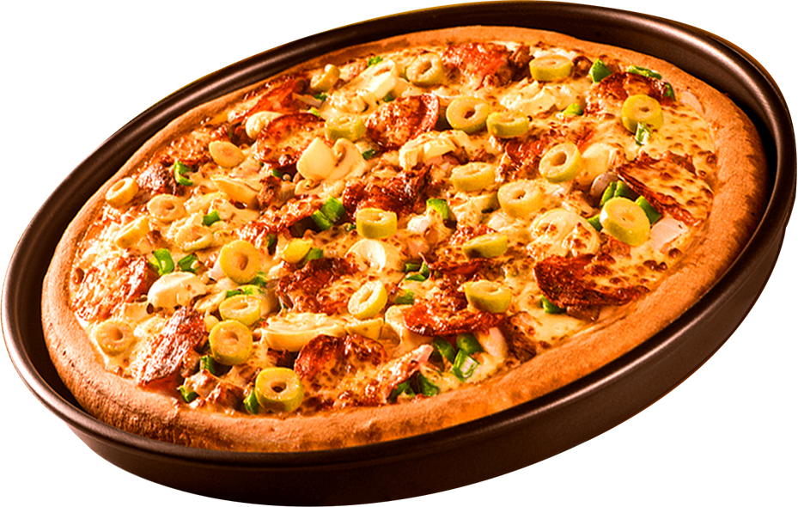
TITLE: ANALYZING PIZZA SALES DATA WITH SQL
SUBTITLE: HOW I USED SQL TO EXPLORE AND UNDERSTAND PIZZA SALES
PRESENTED BY: ANCHITA RAI

Slide 2

PROJECT OBJECTIVE
The objective of this project is to use SQL to explore pizza sales data in detail, with the goal of finding useful business insights. These include identifying the best-selling pizzas, understanding how revenue is distributed across different pizza types, and analyzing patterns in customer orders over time to help make informed business decisions.

Slide 3
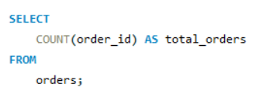
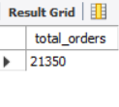
RETRIEVE THE TOTAL NUMBER OF ORDERS PLACED.

Slide 4
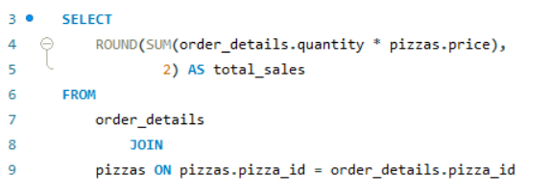

CALCULATE THE TOTAL REVENUE GENERATED FROM PIZZA SALES.

Slide 5
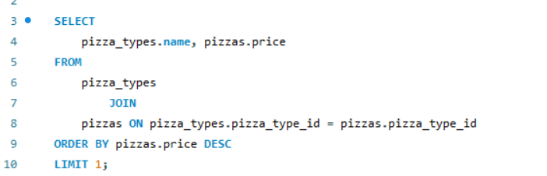

IDENTIFY THE HIGHEST-PRICED PIZZA.
$30
$25

Slide 6
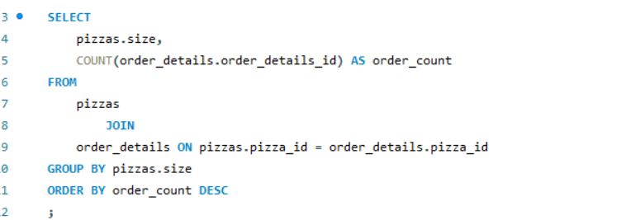
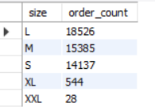
IDENTIFY THE MOST COMMON PIZZA SIZE ORDERED.
$30
$25

Slide 7
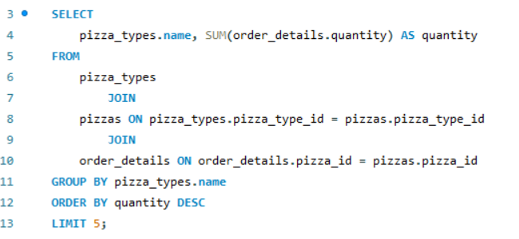
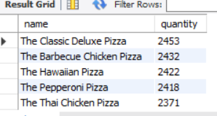
LIST THE TOP 5 MOST ORDERED PIZZA TYPES ALONG WITH THEIR QUANTITIES
$30
$25

Slide 8
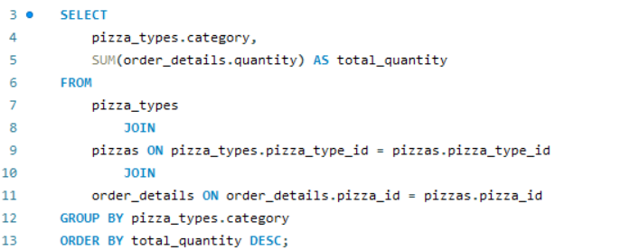
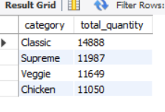
JOIN THE NECESSARY TABLES TO FIND THE TOTAL QUANTITY
OF EACH PIZZA CATEGORY ORDERED.
$30
$25

Slide 9
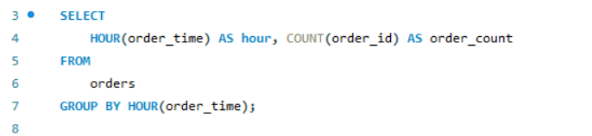
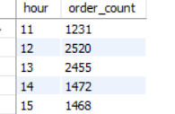
DETERMINE THE DISTRIBUTION OF ORDERS BY HOUR OF THE DAY.
$30
$25

Slide 10
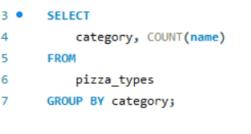
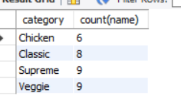
JOIN RELEVANT TABLES TO FIND THE CATEGORY-WISE DISTRIBUTION OF PIZZAS.
$30
$25

Slide 11
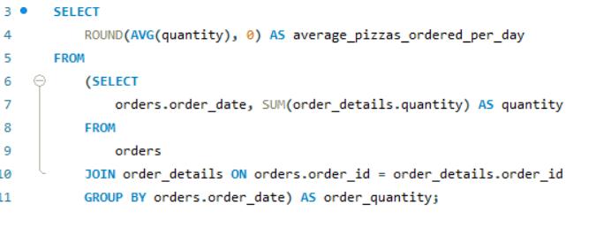

GROUP THE ORDERS BY DATE AND CALCULATE THE AVERAGE NUMBER OF PIZZAS ORDERED PER DAY.
$30
$25

Slide 12
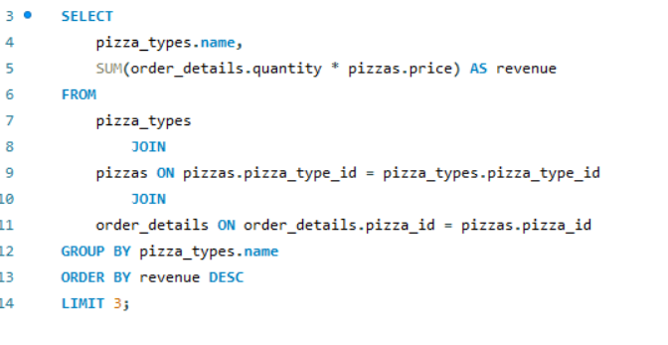
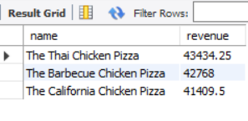
DETERMINE THE TOP 3 MOST ORDERED PIZZA TYPES BASED ON REVENUE.
$30
$25

Slide 13
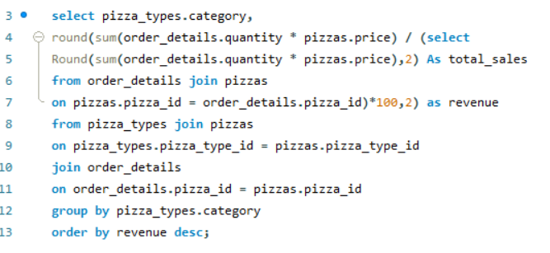
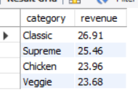
CALCULATE THE PERCENTAGE CONTRIBUTION OF EACH PIZZA TYPE TO TOTAL REVENUE.
$30
$25

Slide 14
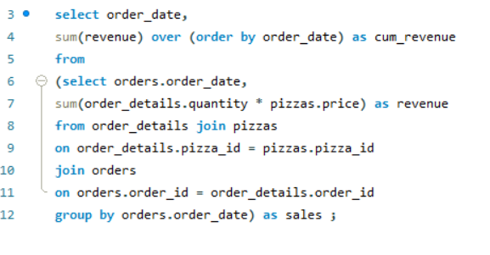
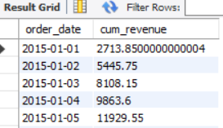
ANALYZE THE CUMULATIVE REVENUE GENERATED OVER TIME.
$30
$25

Slide 15
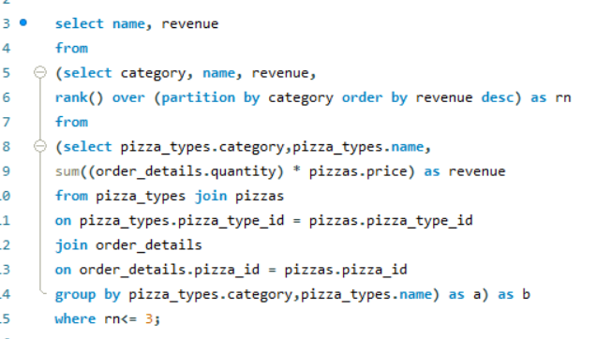
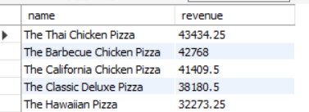
DETERMINE THE TOP 3 MOST ORDERED PIZZA TYPES BASED ON REVENUE FOR EACH PIZZA CATEGORY.
$30
$25

